Slide 1
STORE SALES VOLUME FORECAST
TEAM-2
Sai Jahnavi Gamalapati
Adwaith Ajith Menon
Di Zhao
Jahnavi Adabala
Kartiki Bhargava
1

Slide 2
Table of Contents
01
02
03
04
05
06
Introduction
Data Pre-Processing
Data Exploration
Business Case
Literature
Problem statement
Data Description
Data Restructuring
Summary Statistics
Exploratory Data Analysis
Models
Recommendations
Conclusions & Future Work
Model Exploration
Model Comparision
2

Slide 3
01
Introduction
3

Slide 4
Business Case
For brick-and-mortar grocery stores, which must carefully balance how much inventory to acquire, sales volume estimates are critical. Grocery stores are left with an excess of perishable goods if the forecasts are a little off. Accurate forecasting could help stores ensure they have just enough products at the correct time. If a store can match a product's demand with just the correct amount of supply, there will be no missed sales owing to a lack of inventory and no additional costs due to overstocking.
4

Slide 5
Literature
A time series is a series of observations taken in chronological order. It can be broken down into three parts.: Trend (Change in Time Series), Seasonality (the repetition of a specific pattern of observations after a certain time interval) ,and Irregular component (Random noise). These three components serve as the basis for decomposition techniques that separate original series into individual components. These techniques make up a significant portion of the forecasting literature.
Time-series forecasting problems cannot be solved with a single optimum method. Each issue may be resolved in a different way to cope with time-series forecasting. One of the simplest prediction methods for time series without obvious seasonal patterns is the moving average (MA). A more sophisticated variation of MA known as Autoregressive Integrated Moving Average (ARIMA) has been employed in various papers.
Multivariate ARIMA was effectively used by Huber, Gossmann, and Stuckenschmidt (2017)[1] to forecast demand for perishable items. Another classic forecasting technique known as Seasonal ARIMA (SARIMA) has been successfully used for applications like forecasting tourism demand (Goh & Law, 2002)[2] and predicting the flow of motor traffic (Williams & Hoel, 2003)[3].
Moreover, the forecasting technique of Exponential Smoothing has proven quite effective. For example, Taylor (2011)[4] used a Seasonal Exponential Smoothing approach to forecast the daily sales of a supermarket (which was highly volatile).
5

Slide 6
Problem Statement
The goal of this project is to develop a Time Series Forecasting model that can predict sales volume for a grocery store for 16 days (about two periods). The various models would be compared using evaluation metrics such as MAPE, R2, & RMSE, and the best model would be chosen for final forecasts. Based on the data, we must make recommendations and understand the parameters that are most important in determining sales volume on a given day for a specific store.
6

Slide 7
02
Data Pre-Processing
7

Slide 8
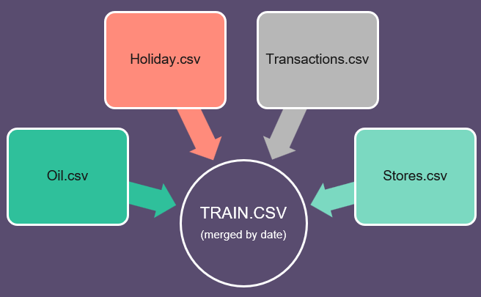
DATA DESCRIPTION
Feature Name | Description | Type
Date | Day wise YYYY-MM-DD | date
Sales | Total sales a particular store | Continuous
Promotion | Total number of items being promoted | Continuous
Oil Price | Day-wise oil price | Continuous
Type_x | Holidays & Events | Categorical
Transaction | Total transactions by date & store | Continuous
locale_name,city, state | Region information | Categorical
Transferred | Whether holiday is transferred to other day | Categorical
cluster | Grouping of similar store | Categorical
family | Identify the type of product sold | Categorical
Store_nbr | Store ID | Categorical
8

Slide 9
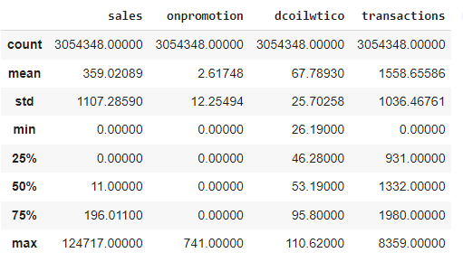
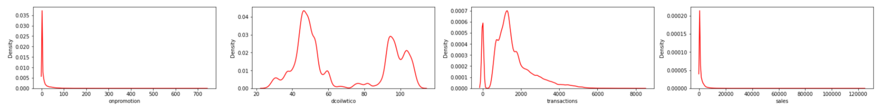
Summary Statistics
We observe sales volume varying from 0 to 124K. A similar trend is observed for promotions.
The distribution curve shows, both promotion & sales are rightly skewed.
With respect to the oil price, we observe bimodal distribution which shows two events where high prices are recorded.
9

Slide 10
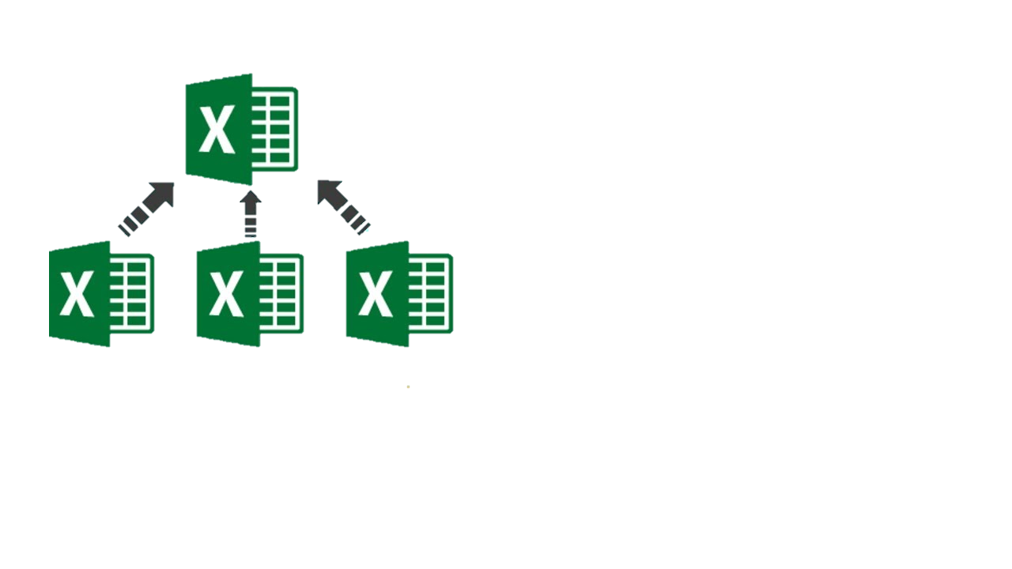
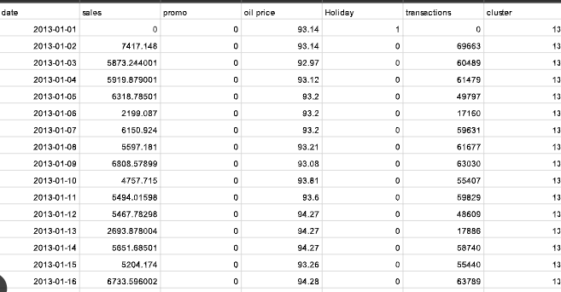

DATA RESTRUCTURING
Merge Datasets
Extract store-level data
User store level data to perform analysis
10

Slide 11
Data Pre-Processing
Extract store level data using store_nbr
Excluded irreverent predictors (like ID, transferred, region information, cluster, store_nbr)
Use as.freq method to convert data to time series with constant period. Used day as period.
Missing values are then replaced using back fill method
(Total Data: 1684 from 1/1/2013 to 8/15/2017
11

Slide 12
03
Data Exploration
12

Slide 13
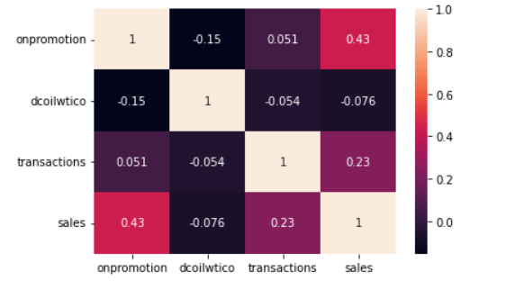
Correlation between Continuous variables
Following are correlations observed between predictors
Promotion and sales
Transactions and sales.
13

Slide 14
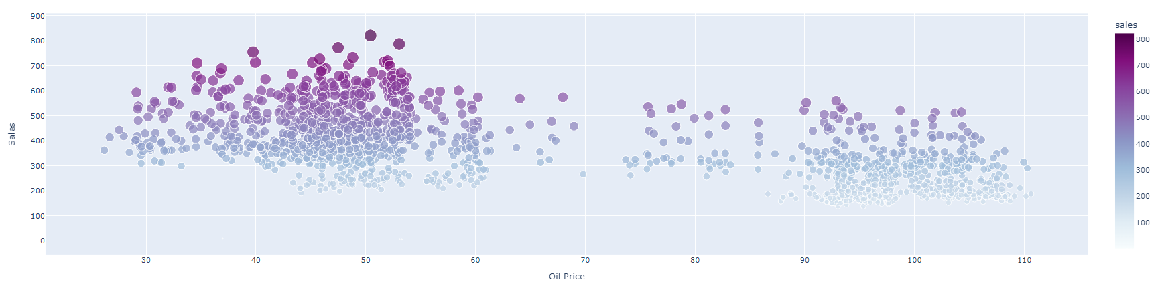
Oil price vs Sales
It is clear from the above graph, that lower oil prices mean more sales volume. The decrease in sales volume when oil prices are high may be attributed to increased operating costs resulting in increased prices and causing low purchasing power.
14

Slide 15
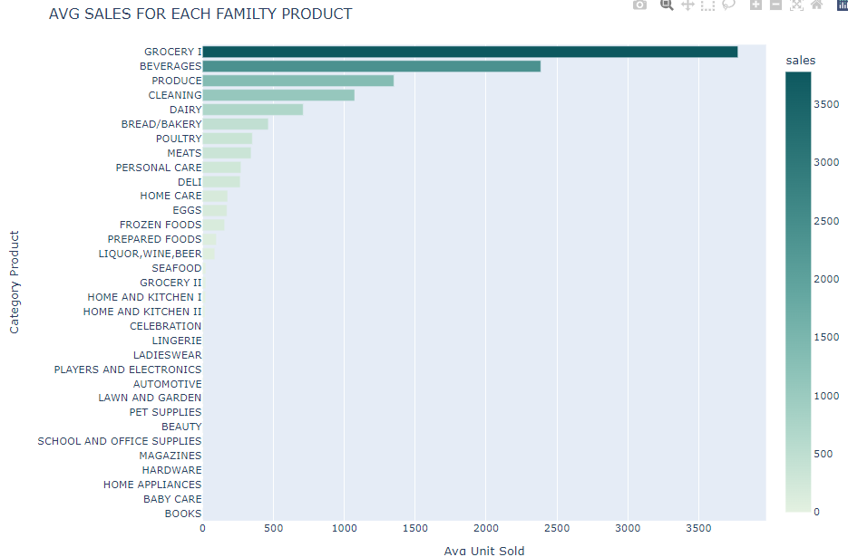
Where is Sales volume concentrated?
Average sales for a different family of products. Groceries are most sold, hardware is least sold
15

Slide 16
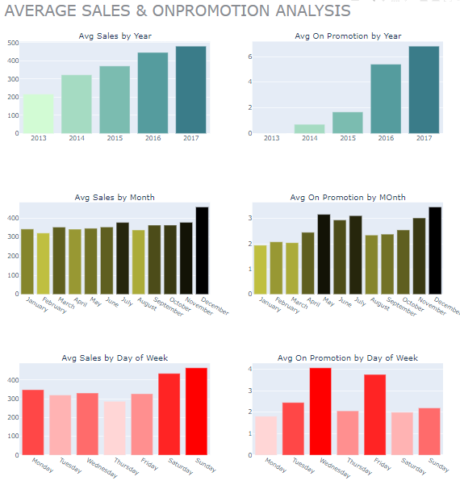
Avg Sales / Promotion
There's an increasing trend in sales every year.
December is the month with the highest average units sold (Christmas is in December).
During the weekends customers purchase more
compared to weekdays.
There has been an exponential increase in promotions throughout the years. No promotions in 2013.
Highest promotions are during summer (June, July)
and December (Christmas).
Although the highest sale on Sunday, the highest promotions are on Wednesdays and Fridays.
16

Slide 17
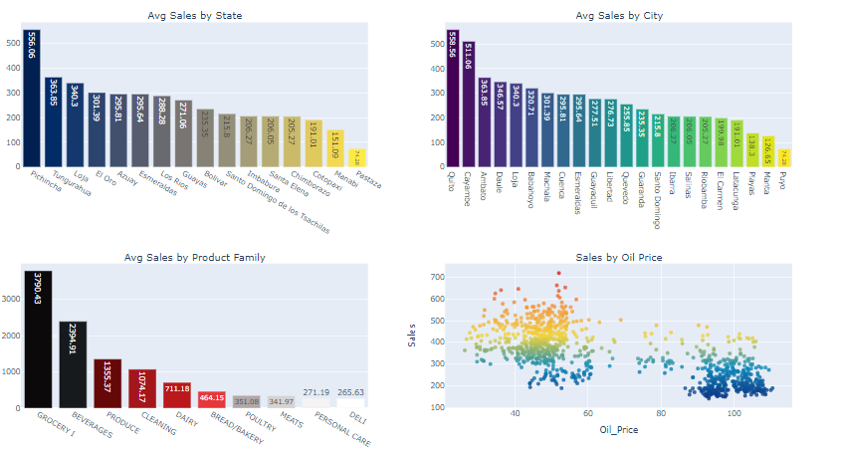
Avg Sales by State/City/Product/Oil
The bottom right graph shows oil prices versus sales over time. There’s an indirect trend in sales every year with increase in oil price. It probably has to do with the decrease in oil prices (as it gives more purchasing power to consumers).
17

Slide 18
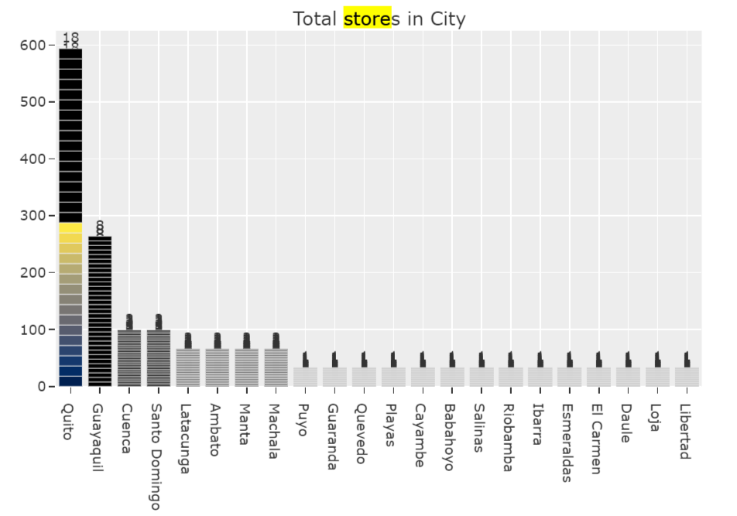
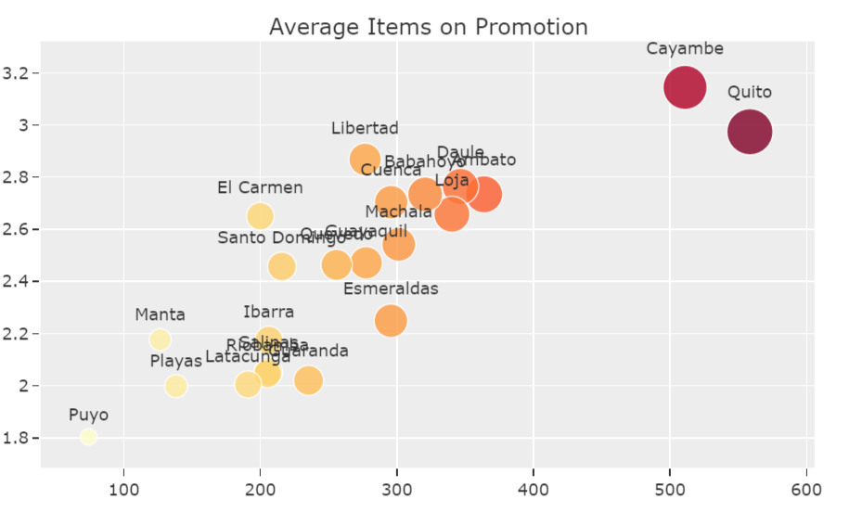
Total Stores/Promotions per city
We see that Guayaquil is the second city with the most stores with a total of 8 but still 10 less stores than Quito which has 18 in total
We see that Cayambe has the highest average of items in promotion which probably help it become the second highest in average sales
18

Slide 19
04
Modeling
19

Slide 20
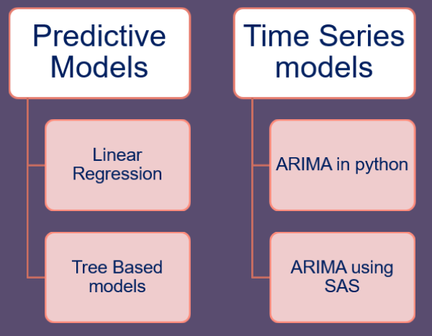
OVERVIEW OF MODELING
20

Slide 21
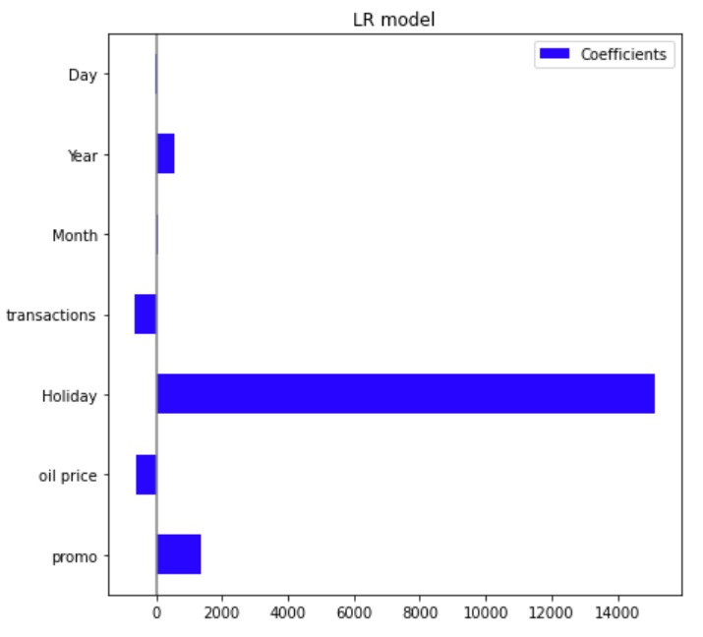
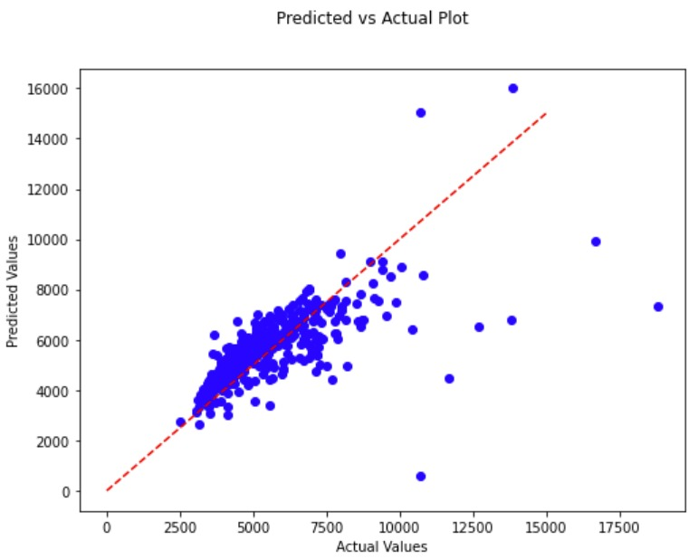
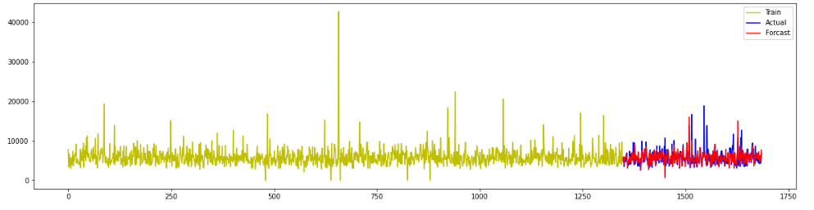
Linear Regression Model
Holidays and promotions are the factors that have the biggest impact on sales.
Oil price has a negative impact on sales.
21

Slide 22
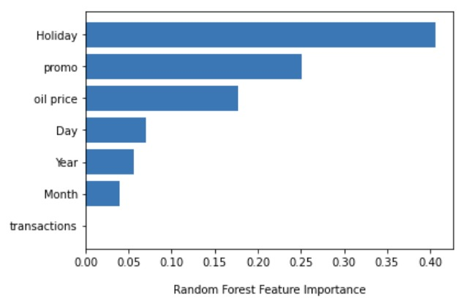
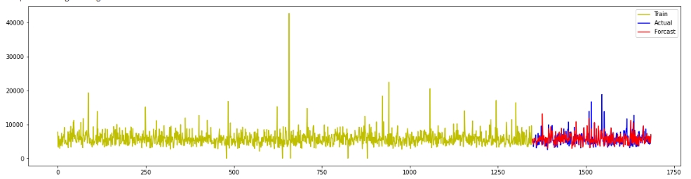
Random Forest Model
Similar conclusion to linear regression, holidays and promotion are the two biggest influences on sales. Oil price is also a factor that should be considered. Higher prices mean fewer clients and low sales.
GridSearch Best Parameters:
n_estimators: 200
max_depth: 9
max_features: 4
min_samples_leaf: 2
min_samples_split:10
22

Slide 23
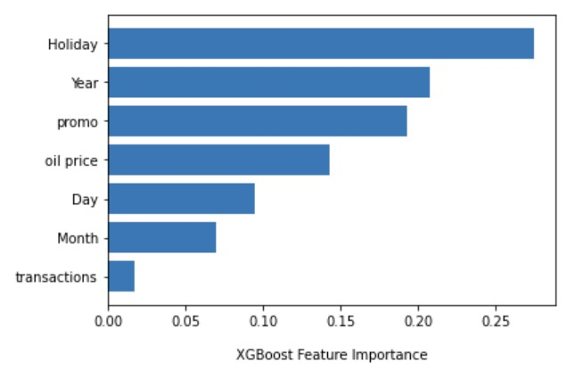
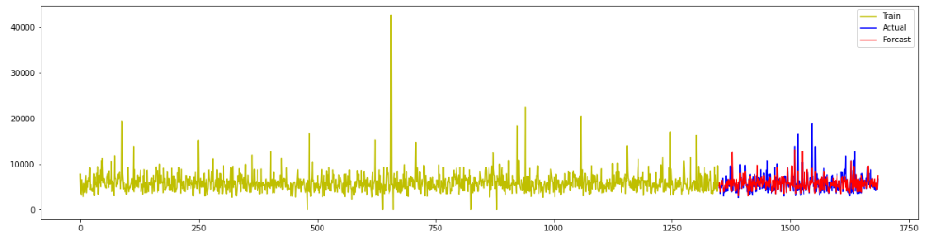
XGBoost Model
Holiday & Promotion: high sales
Sales grows as the year increases
Oil price: lower sales
GridSearch Best Parameters:
eta: 0.02
max_depth: 5
subsample: 1
23

Slide 24
Time Series Analysis in Python
24

Slide 25
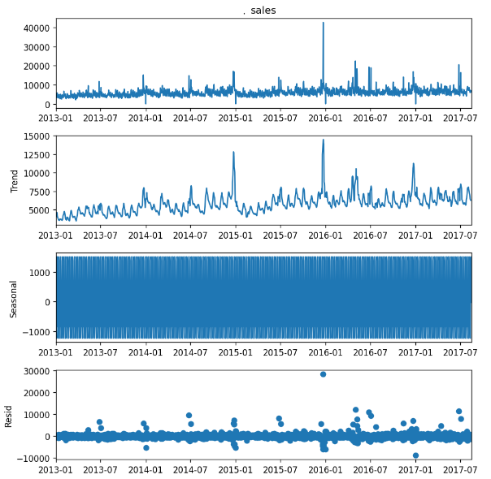
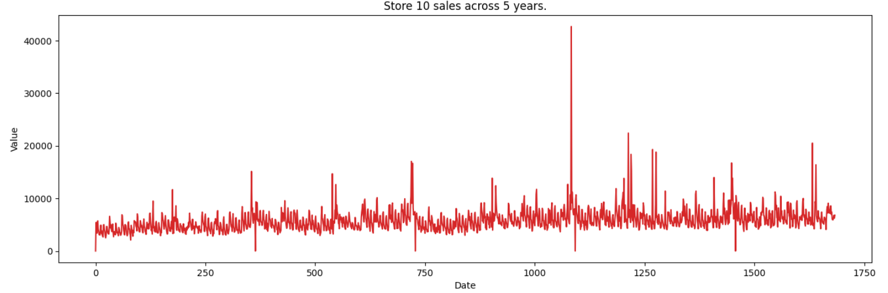
Time Series Exploration
ADF Statistic: -5.45
n_lags: 2.5e-06
p-value: 2.57e-06
Critical Values: 1%, -3.43
Critical Values: 5%, -2.81
Critical Values: 10%, -2.5
Seasonal Decomposition
25

Slide 26
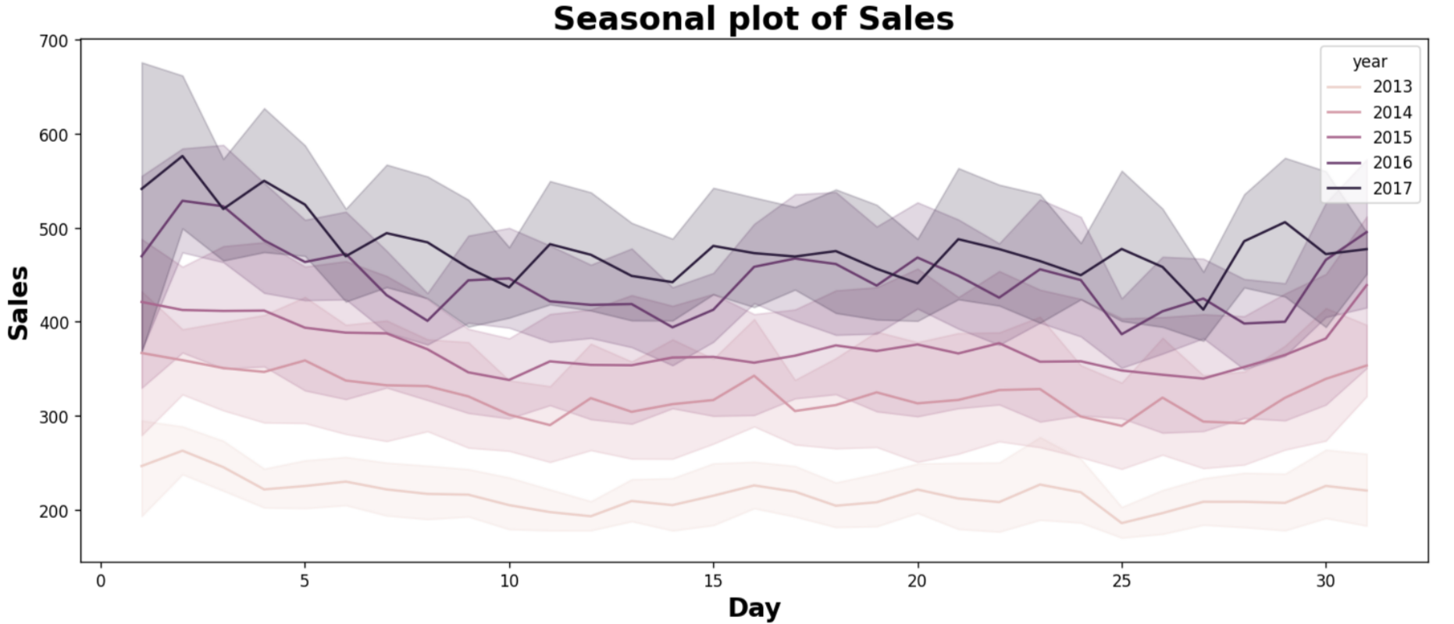
SEASONALITY
We can see some seasonal pattern.
26

Slide 27
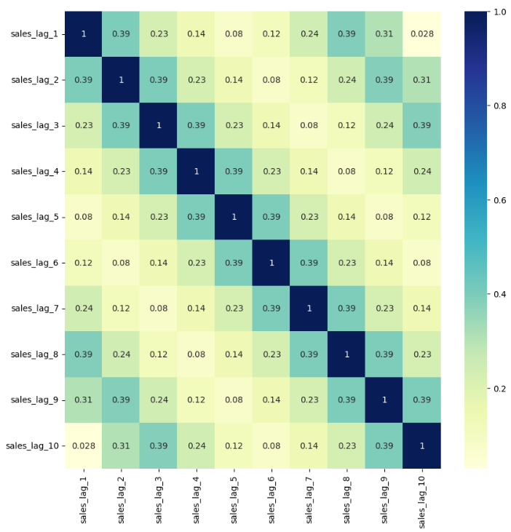
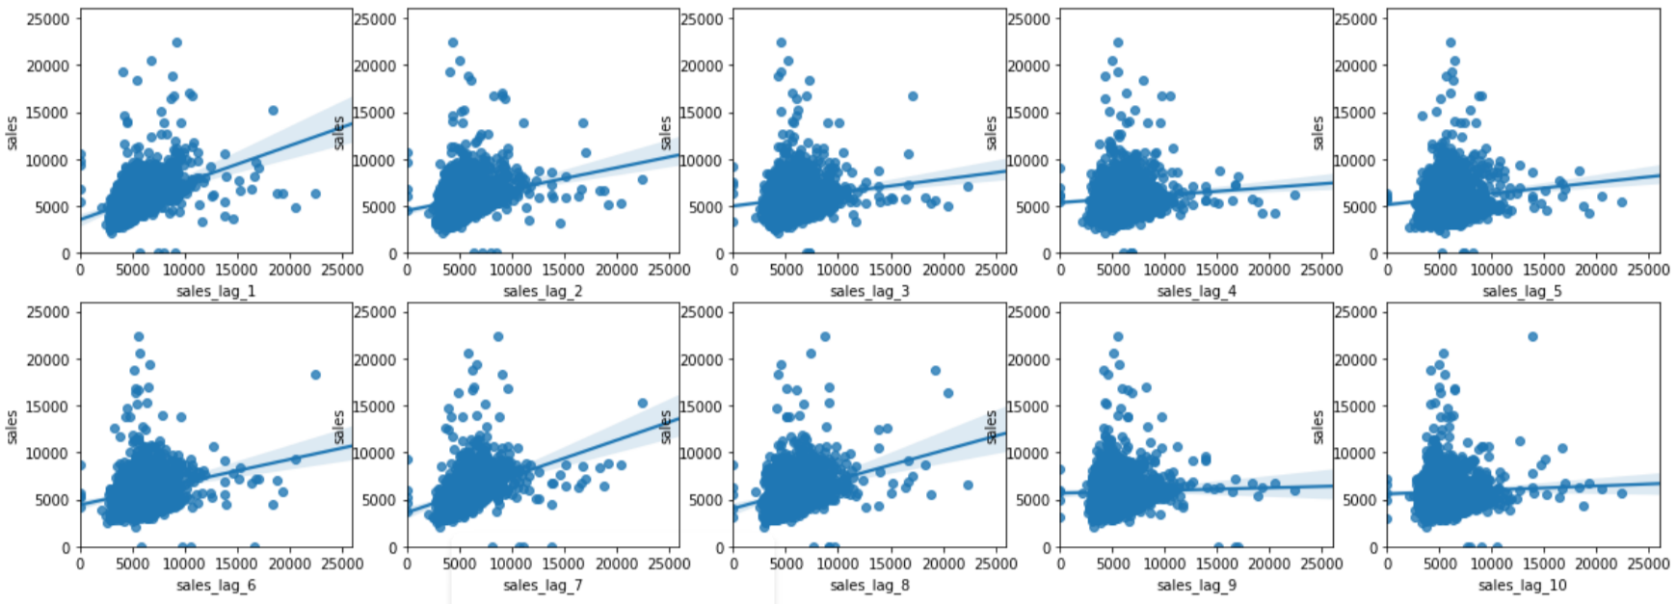
LAGGED CORRELATIONS
Here we observe a correlation with different lags.
Especially, the highest correlation of 0.39 was observed every consecutive day and once every 8 days.
No correlation is observed after every 5, 10 days.
27

Slide 28
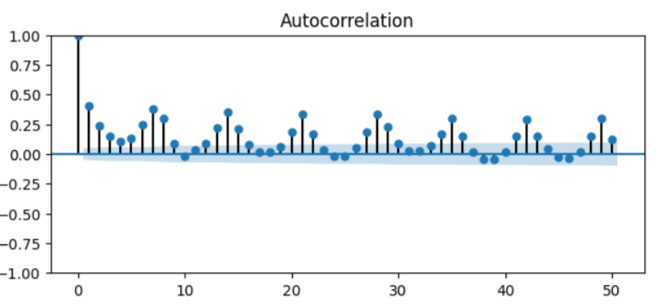
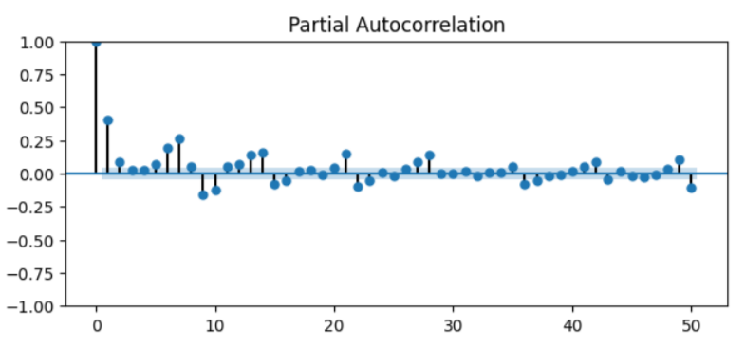
ACF & PACF plots
ACF with significant values at lags that are multiples of 7, which implies there is seasonality every 7 days.
PACF cancels out all additional channels a previous lag period affects the present one. We are seeing negative value at lag period 9 which implies higher sales values 9 days ago will cause lower values today.
28

Slide 29
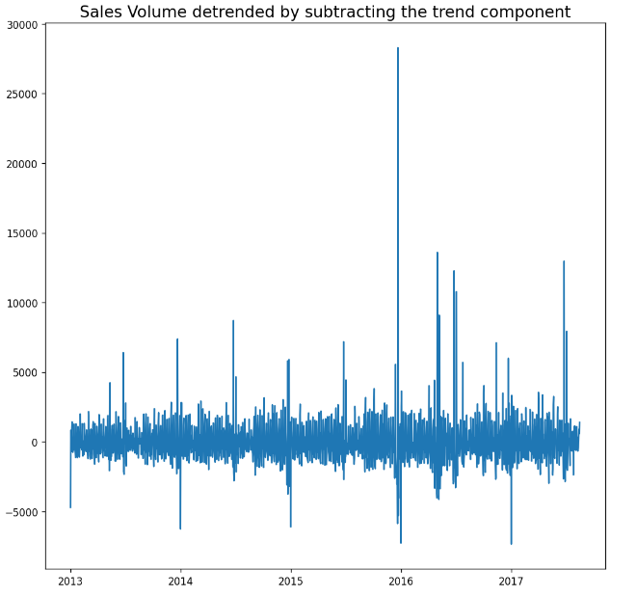
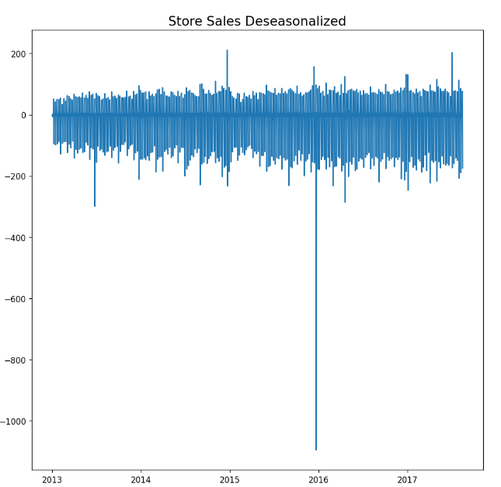
DETREND & DESEASONALIZE
Fit a line and subtract series from the fitted line to cancel the trend
Take a moving average with length as the seasonal window. This will smoothen in series in the process. Seasonal difference the series (subtract the value of previous season from the current value). Divide the series by the seasonal index obtained from STL decomposition
29

Slide 30

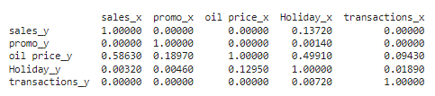
CAUSALITY TEST
Since we have multiple series, we performed the Granger Causality test to determine whether one-time series is useful for forecasting another.
Null Hypothesis (H₀): Time series x does not Granger-cause time series y
Alternative Hypothesis (H_{A}): Time series x Granger causes series y
“Granger-causes” means that knowing the value of time series x at a certain lag is useful for predicting the value of time series y at a later time period.
The row is the response (y) and the columns are the predictors (x). If a given p-value is < significance level (0.05), for example, take the value 0.0 in (row 1, column 2), we can reject the null hypothesis
30
Holiday, promotions, transactions are shown significant

Slide 31
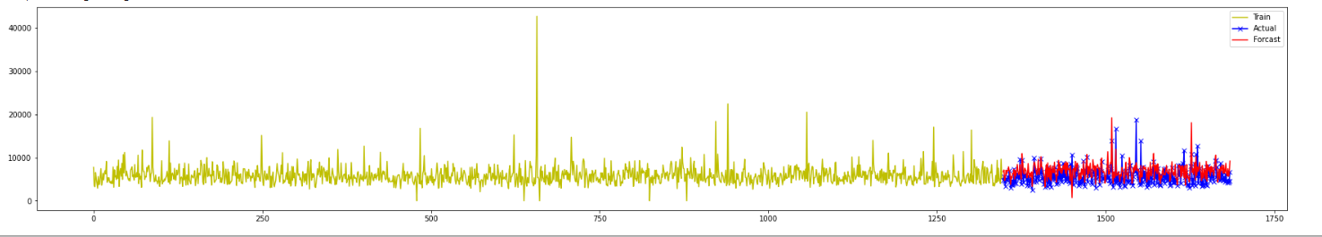
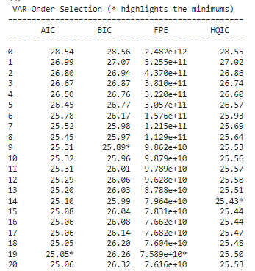
Vector ARIMA results (for Sales)
The best model was selected based on the lowest AIC. Achieved lowest AIC at 19th lag.
31

Slide 32
Time Series Analysis in SAS
32

Slide 33
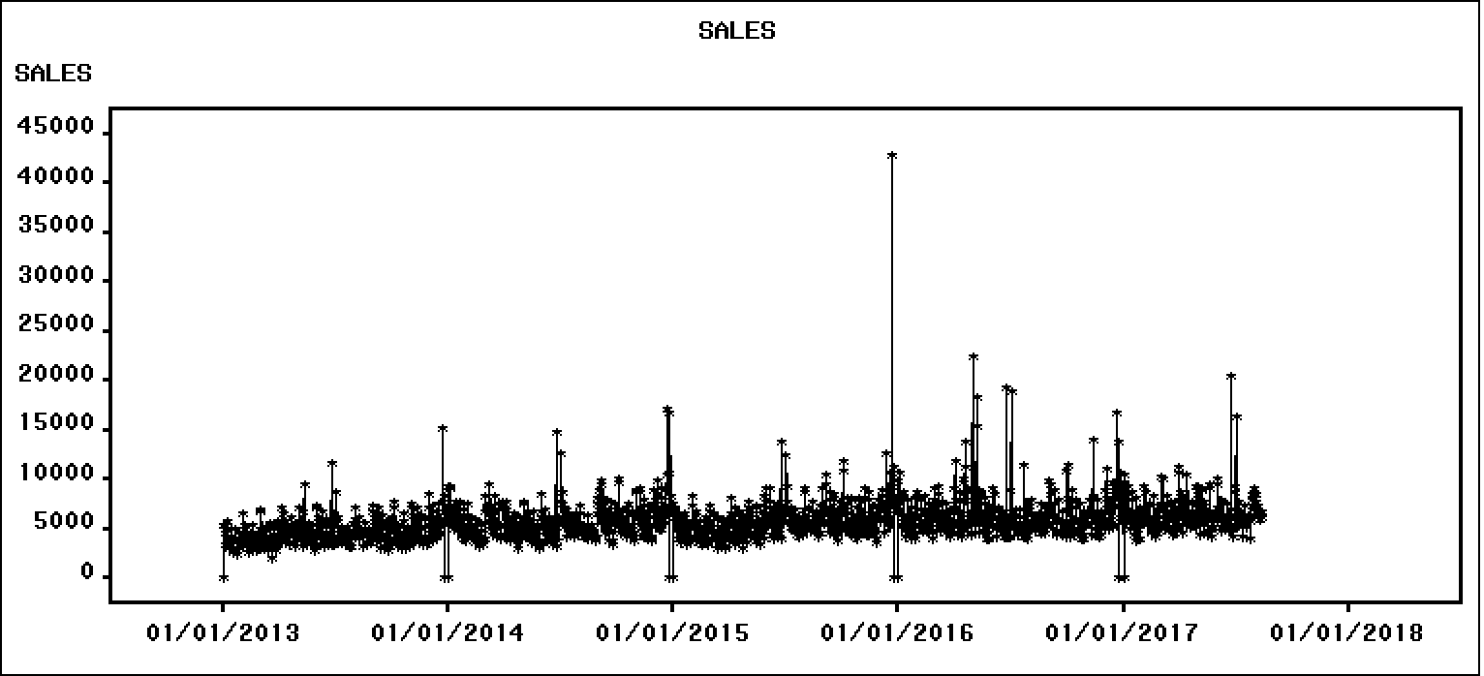
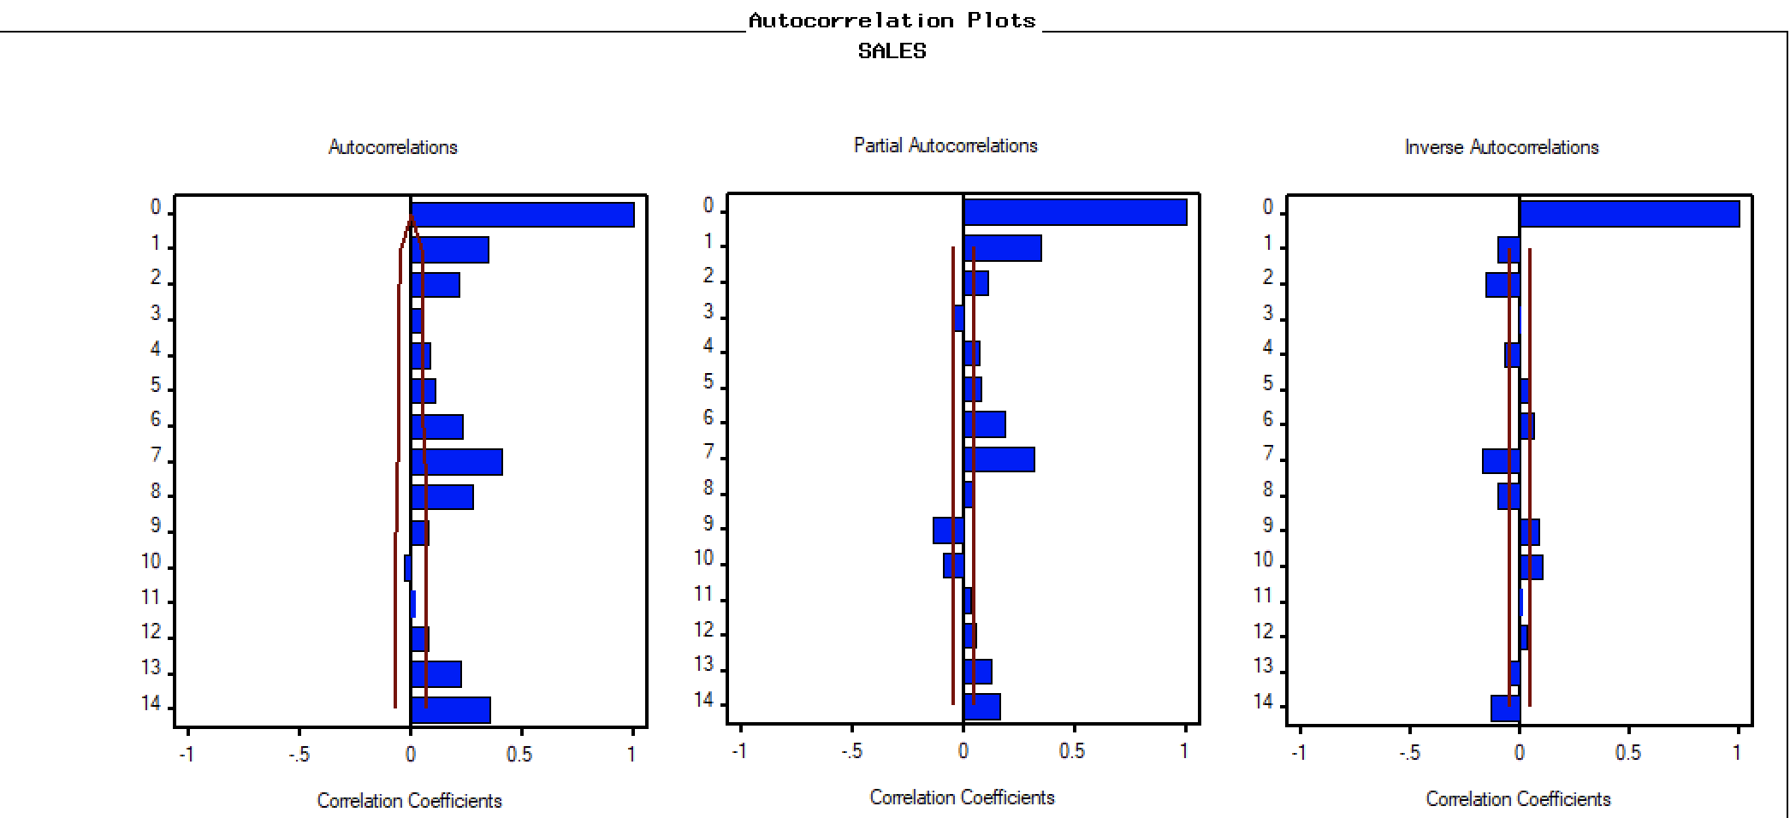
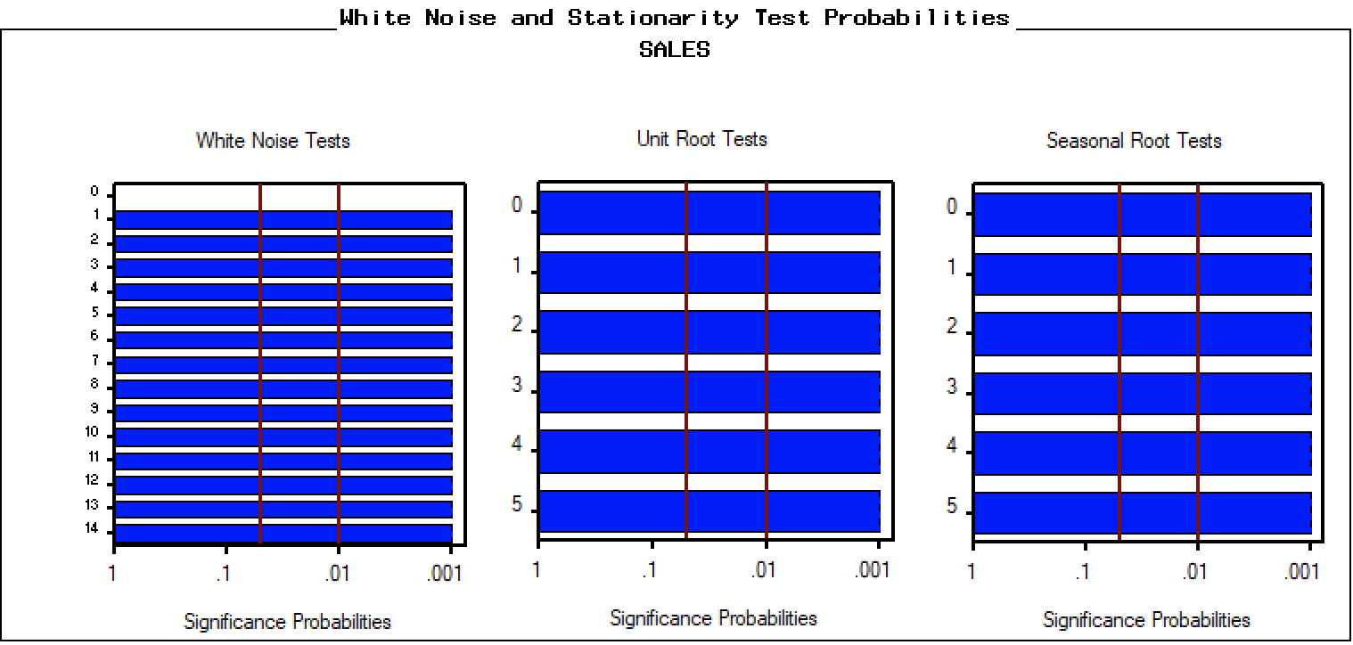
TREND/SEASONALITY/NOISE TESTS (BEFORE MODELING)
Slightly trend
Seasonality
Outlier
Cycle in 7 days
Data is not white noise
There is no trend
There is no seasonality
33

Slide 34
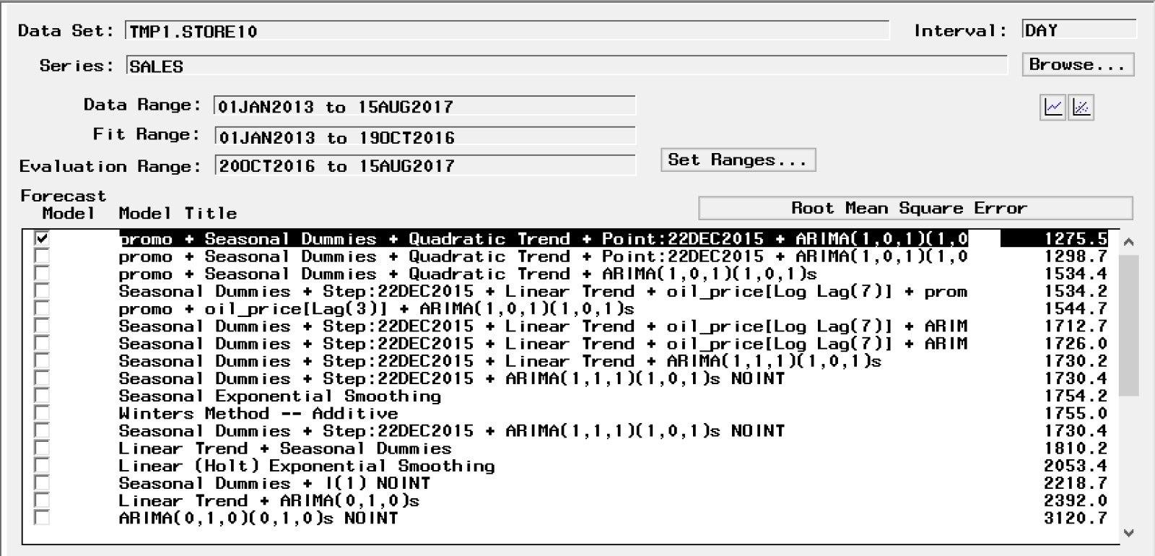
BEST MODEL
Best Model: promo + Seasonal Dummies + Quadratic Trend + Point: 22DEC2015+ ARIMA(1,0,1)(1,0,1)s
Basic Model: ARIMA (1,0,1)(1,0,1)s
Trend: Quadratic Trend
Seasonality: Seasonal Dummies (6 dummies)
Regressor: promo
Event: 22DEC2015
34

Slide 35
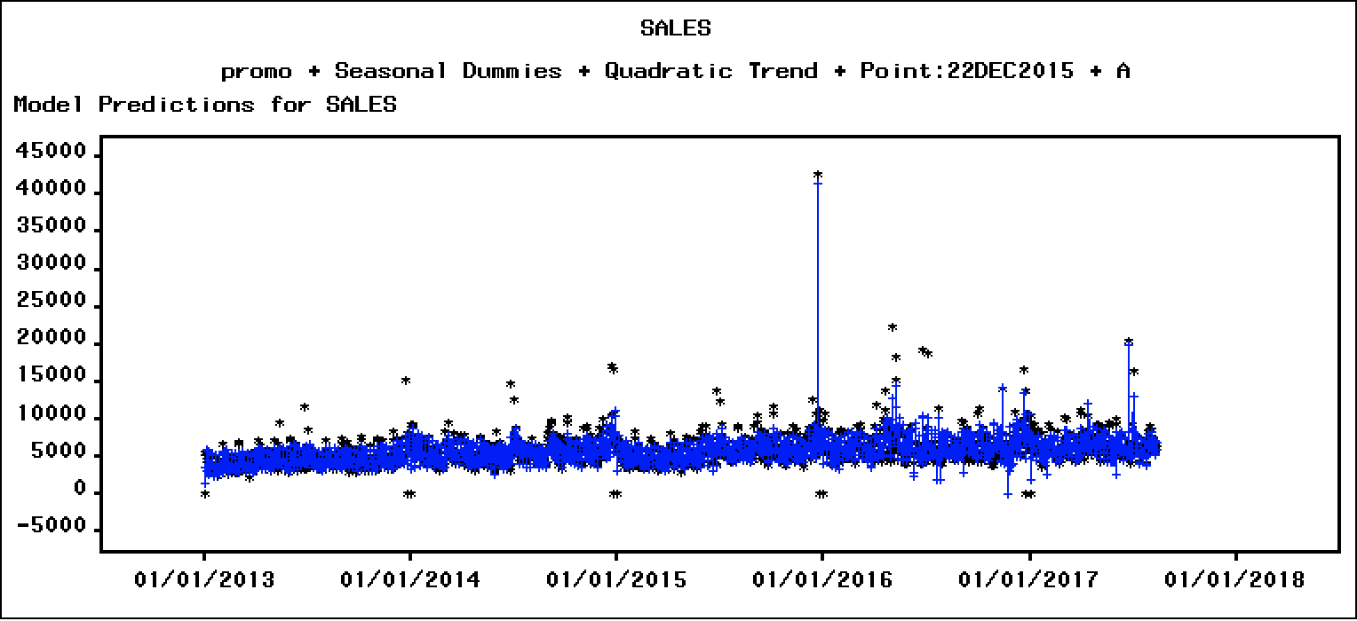
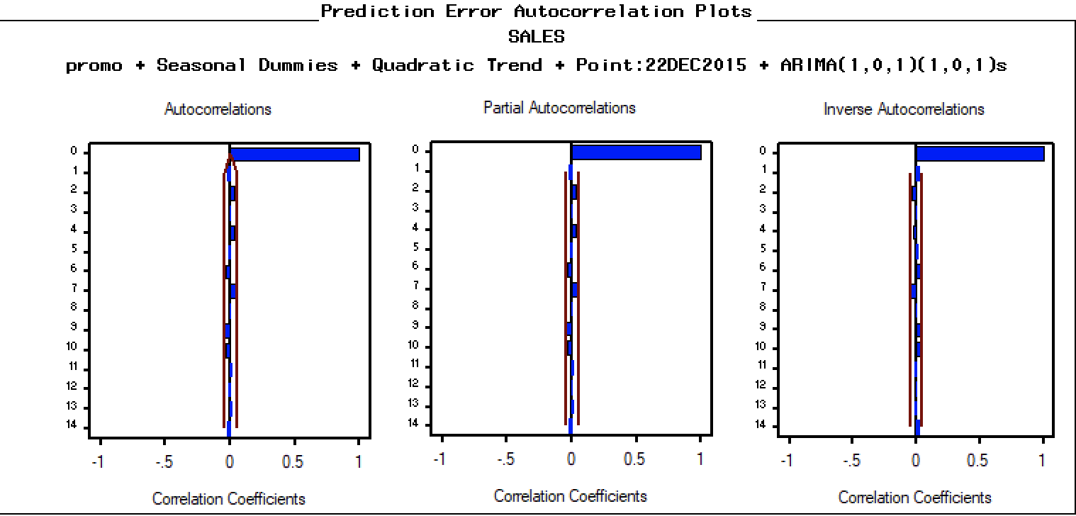
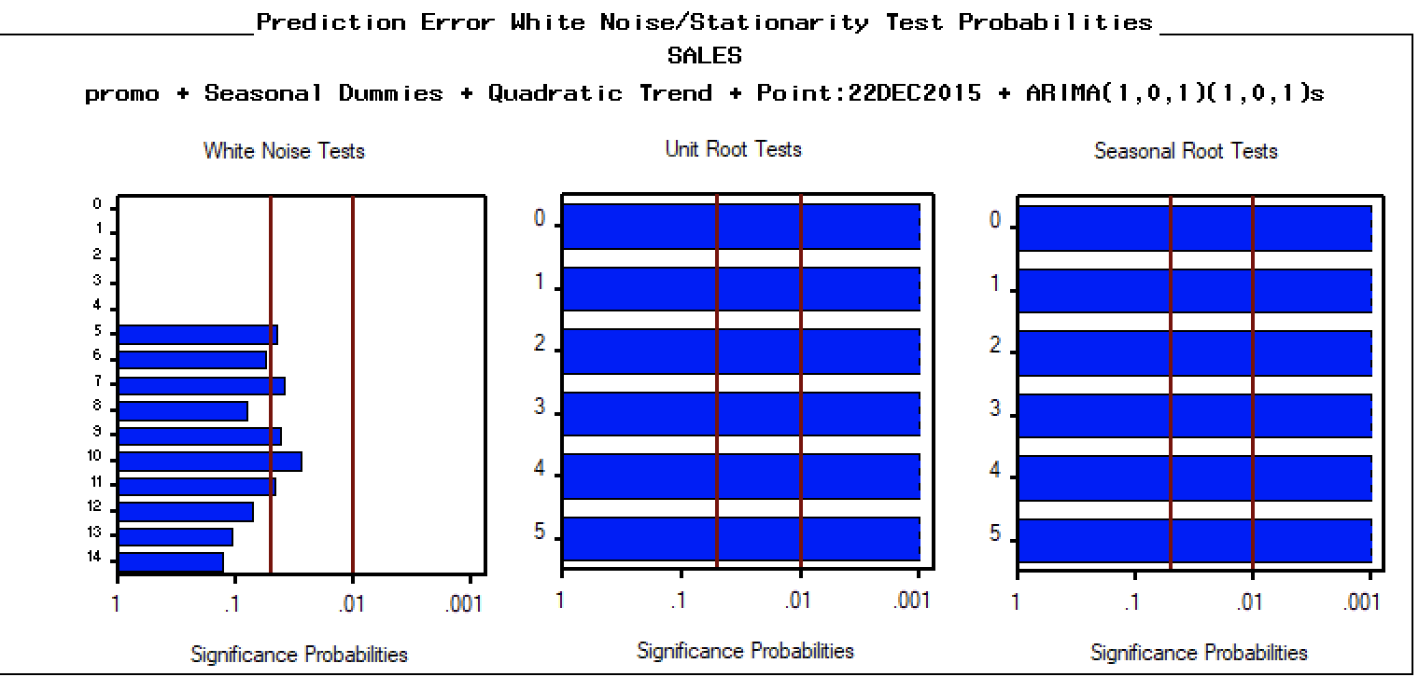
TREND/SEASONALITY/NOISE TESTS (AFTER MODELING)
Actual vs Prediction
No autocorrelations
No partial autocorrelations
Residual is white noise
35

Slide 36
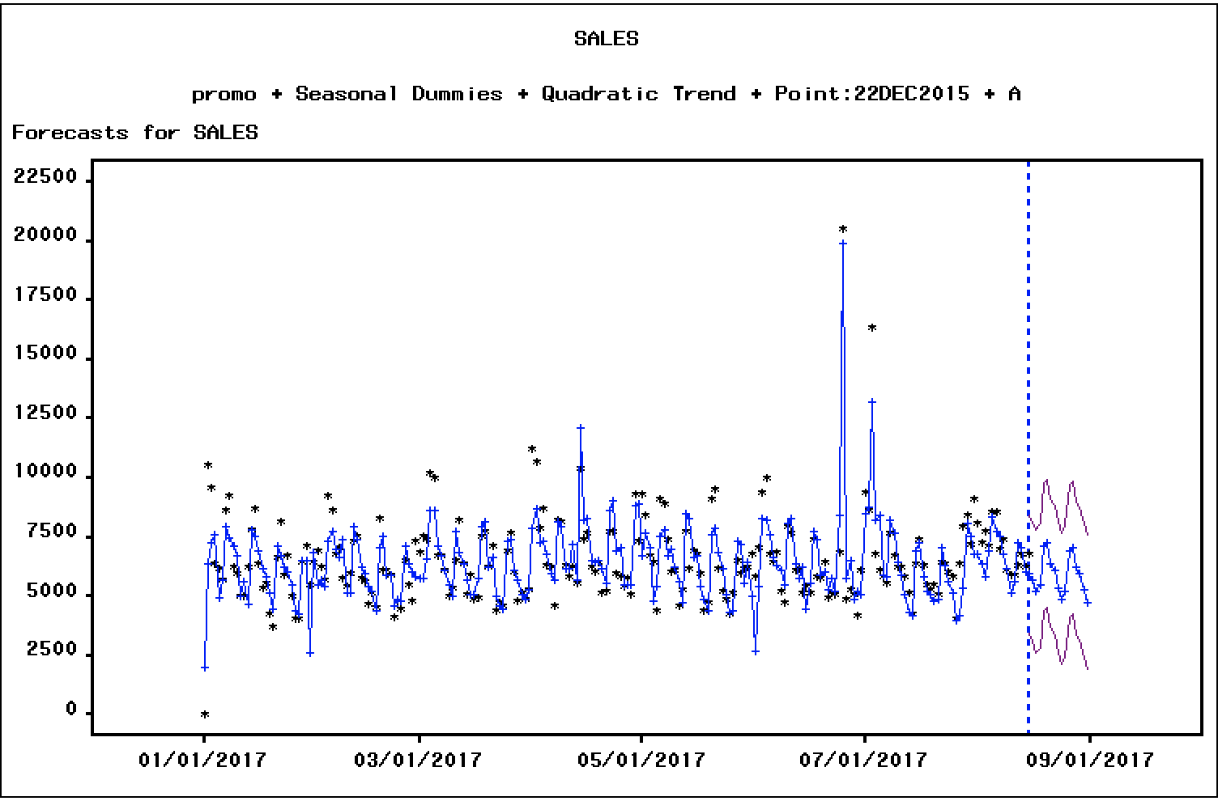
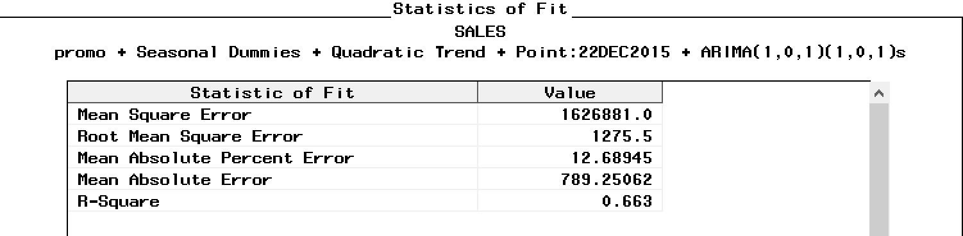
MODEL FORECAST
We forecasted for 16 days (about 2 and a half weeks)
36

Slide 37

Model Comparison (store_10)
Linear
Regression
Random
Forest
XGBoost
Time Series
in Python
Time Series
in SAS
RMSE: 1494.1
MAPE: 0.15
R²: 0.45
RMSE: 1280.1
MAPE: 0.13
R²: 0.6
RMSE: 1286.9
MAPE: 0.12
R²: 0.59
RMSE: 1770
MAPE: 0.32
R²：0.40
RMSE: 1275.5
MAPE: 0.127
R²: 0.663
37

Slide 38
05
Recommendations
38

Slide 39

Optimizing Shelf Space
Products related to Hardware, Clothing, and Beauty are the least sold. We would recommend to allocate the shelf space for these items based on sales volume. The shelf space should be assigned in a way so that the best-selling products like Grocery Products & Beverages are placed towards the end of the store. Since they are the most sold , the customers would travel inside the store to purchase these items & the least sold items like Hardware & Clothing should be placed on shelves & aisles that can attract the customers' attention (near the entrance of the stores) thereby increasing their sales.
39

Slide 40
Leveraging Number of Stores
In spite of having 2nd highest number of stores, the average sales for the city of Guayaquil are found to be lower than the average sales for cities Cayambe, Ambato, and Daule since the numbers of items on promotion for these cities are higher. We would recommend stores in the city of Guayaquil to increase promotions to leverage their store count within the city for better sales.
40

Slide 41


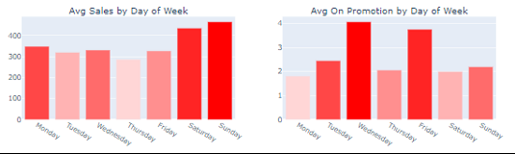
Thrifty Thursdays
Average daily sales are found to be the least on Thursdays. We identified the reason for this to be fewer promotions on Thursdays. We recommend the stores to start a campaign such as “Thrifty Thursdays” to attract customers , where in the number of items on promotion across all product families would be the highest on Thursdays.
41

Slide 42
Reasonable Work Schedule
One way to reduce labor costs would be to have a more streamlined staffing schedule. For instance, the volume of sales is less on weekdays when compared to the Weekends. We would recommend to reduce the number of active counters on weekdays which would imply decreased labor costs.
42

Slide 43

Customer Retention
We observed a decrease in sales volume with the increase in oil prices (due to an increase in logistics costs).
During such times of inflation, we would recommend stores to start loyalty or rewards programs through membership as this would motivate customers to make repeated purchases. Showing customers this appreciation can go a long way toward customer retention.
43

Slide 44
CONCLUSIONS & FUTURE WORK
When comparing results at the store level our best model achieved the lowest RMSE than most of the submissions on the Kaggle competition.
With advanced computational power, we can explore advanced models like Recurrent Neural Networks, and Seasonal-ANN to get more accurate forecasting.
44

Slide 45
References
https://www.sciencedirect.com/science/article/pii/S2667096822000027#bib0027
https://www.sciencedirect.com/science/article/pii/S2667096822000027#bib0022
https://www.sciencedirect.com/science/article/pii/S2667096822000027#bib0073
https://www.sciencedirect.com/science/article/pii/S2667096822000027#bib0066
https://blog.hubspot.com/service/retain-customers-in-inflation
https://www.sciencedirect.com/science/article/pii/S2667096822000027
http://cs229.stanford.edu/proj2017/final-reports/5244336.pdf
https://www.researchgate.net/publication/350935708_Time_series_forecast_of_sales_volume_based_
45

Slide 46
Thanks!
Do you have any questions?
46

